Slide 1
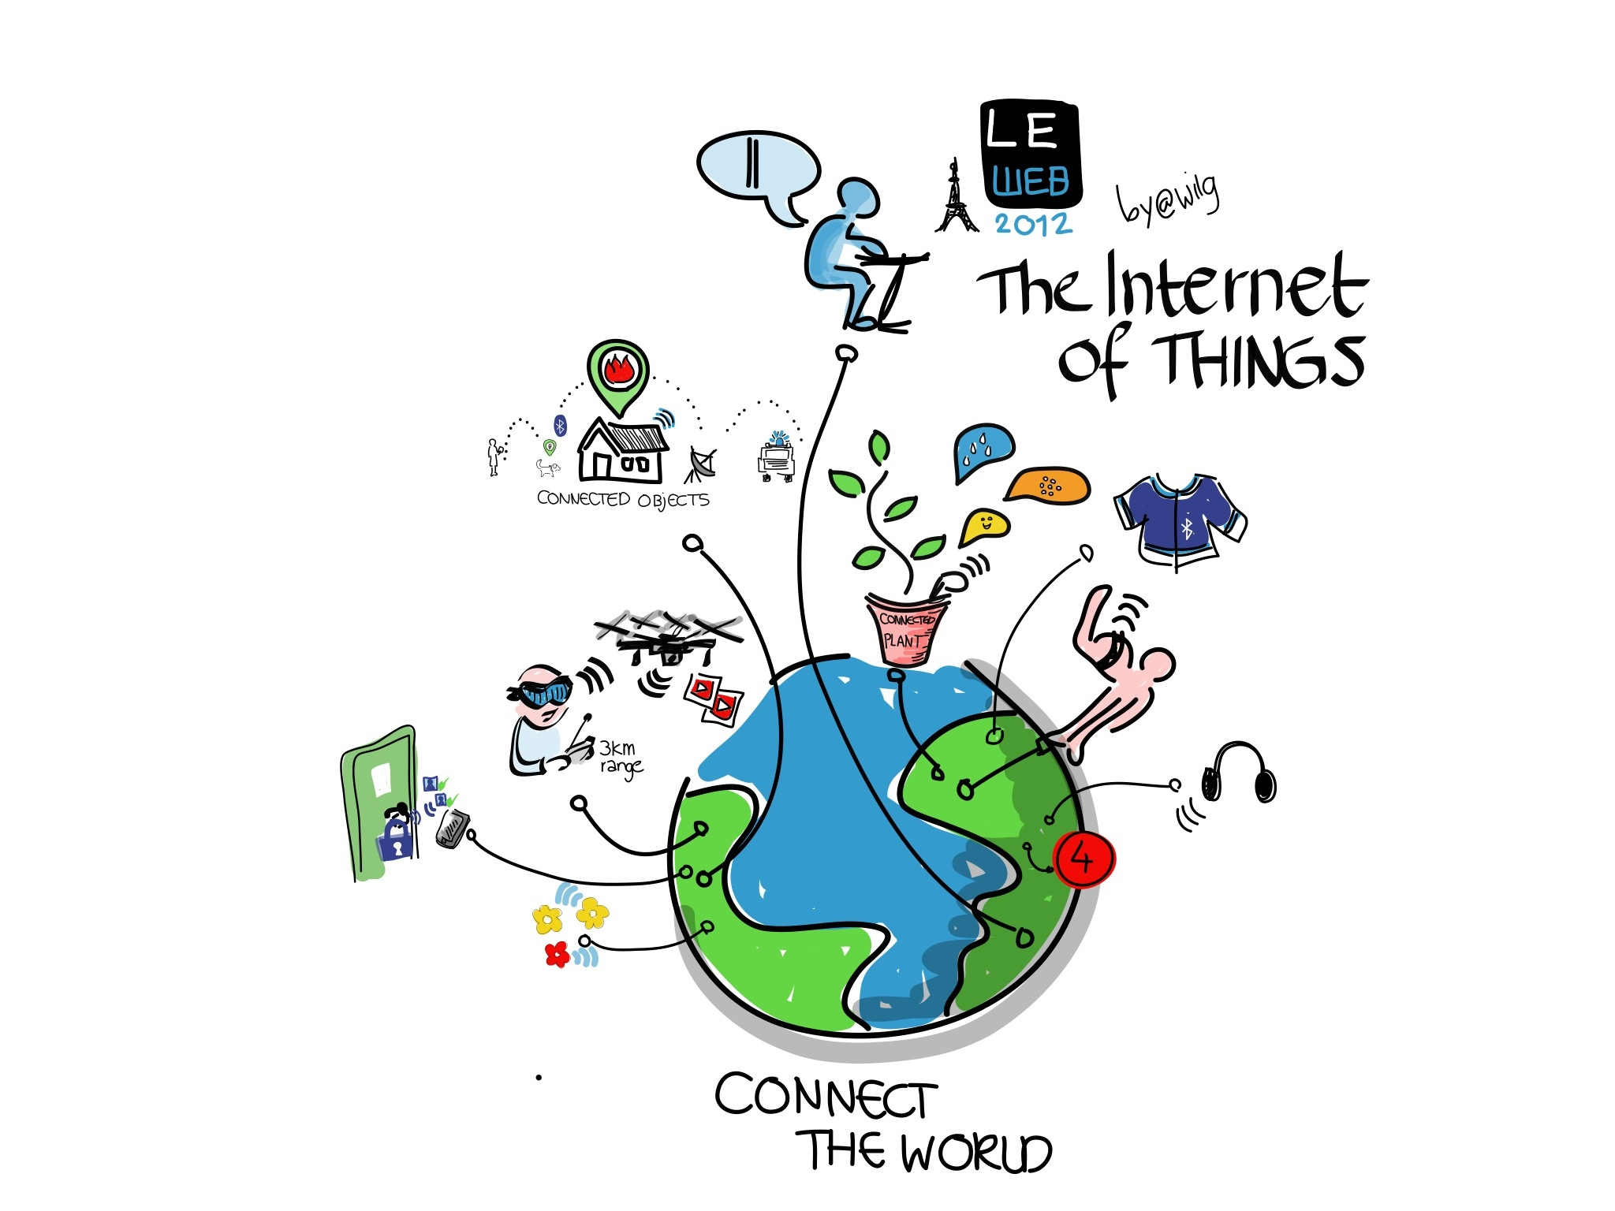
SAUSD
Get Started Hotspot Information

Slide 2
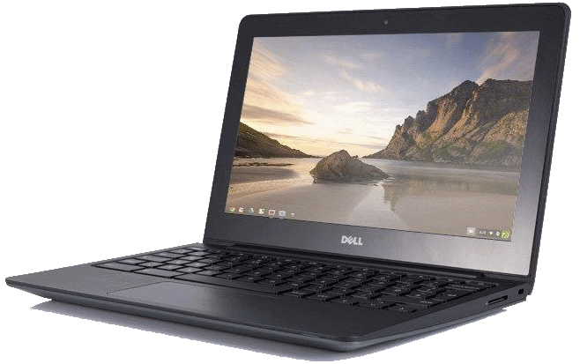
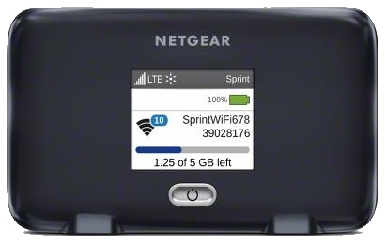
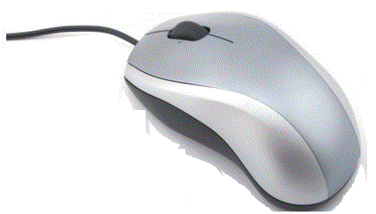
Connecting From Home
To connect a Chromebook at home you will need a home wireless network or a WiFi hotspot
As a graduate of the Digital Citizenship Academy your school site will provide you with:
Chromebook
Mouse
Sprint Netgear WiFi Hotspot
Note: Your school can help connect your Chromebook to your hotspot.

Slide 3
What is a Wireless Network and/or WiFi
A wireless network uses radio waves to connect laptops, cell phones and other devices to the Internet.
When you connect any device to a WiFi hotspot at a cafe, library, or other public place you are connecting to that business’s wireless network
SAUSD Chromebooks connect to the Internet using wireless network connections.

Slide 4
What is a Hotspot?
A hotspot allows you to connect wirelessly to Chromebooks and iPads. The hotspot has a network name and password that will need to be entered in the device in order for the hotspot to provide Internet access.
Video Connecting Your Chromebook to WiFi
Notes:
Info is on the slide. Hotspots come with a user guide, your school site will also be able to help with hotspot setup.

Slide 5
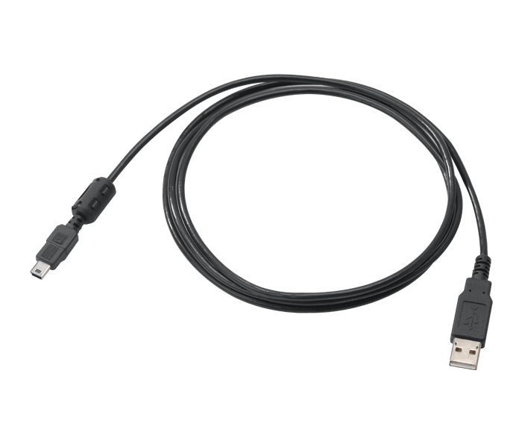
Get Started with NETGEAR Hotspot What’s in the Box
Get Started Guide
Charging Adapter
Hotspot Device
USB Cable
*For your convenience the battery has already been installed.

Slide 6
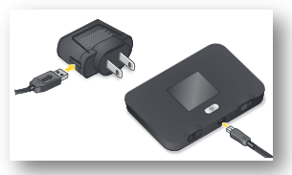
Before You Start
Charge the Hotspot Battery
1.Insert the USB cable into the charging adapter.
2.Insert the small end of the USB cable into the hotspot charging port at the bottom of the hotspot.
3.Plug the charging adapter into a standard AC power outlet.

Slide 7
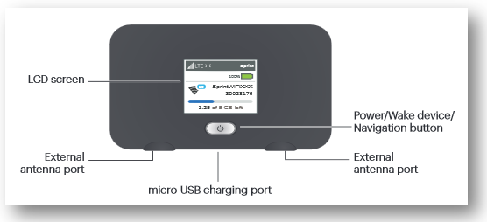
Your Hotspot Device

Slide 8
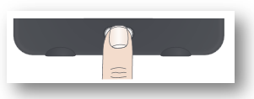
Get Connected
Power Up the Device
If the device is not powered on, press and hold the Power button on the front of the device for at least two seconds. He device will automatically activate.
Note: It can take several minutes for your device to connect with the Sprint network.

Slide 9
Main LCD Screens
You can view basic settings and alerts on the LCD screen. Press the Navigation button to scroll through the following screens:
Video: Connecting Your Chromebook to WiFi

Slide 10
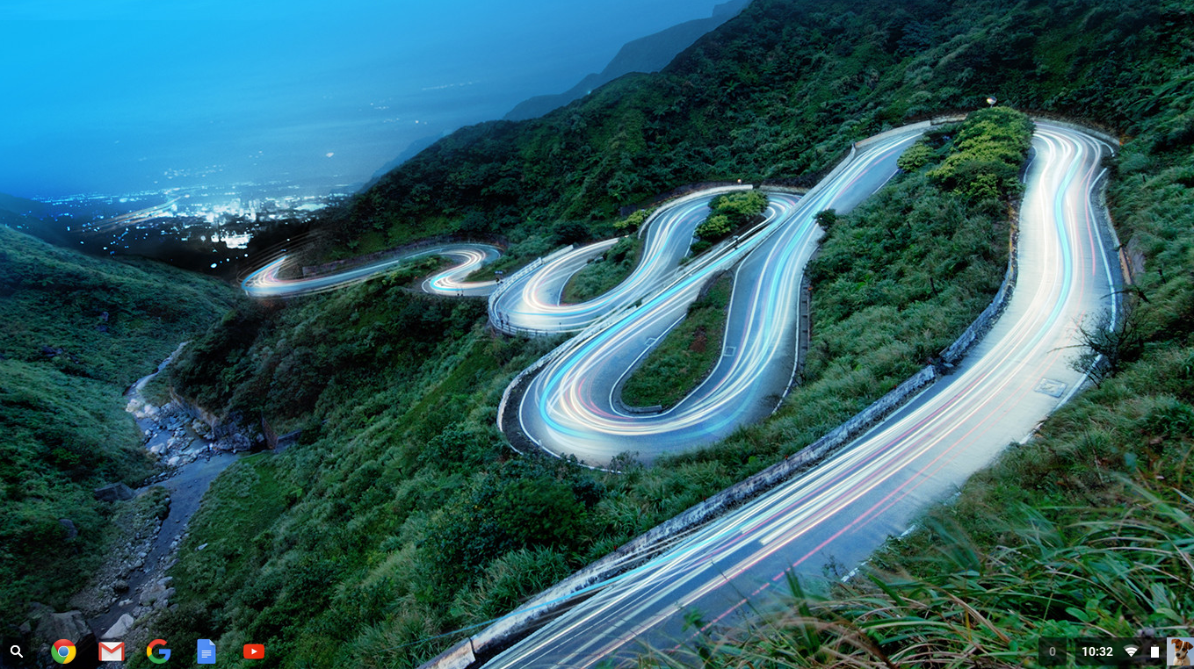
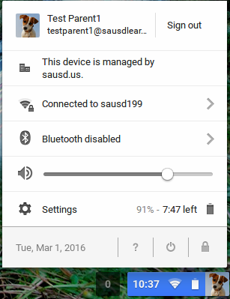
Connect the Chromebook to the hotspot
Video: Connecting Your Chromebook to WiFi
Turn on your Mobile Hotspot and your WiFi-enabled Chromebook.
2. Open the Wi-Fi application on your Chromebook to connect to your WiFi network (Lower right corner)
3. Click the forward arrow to find the wireless network you wish to connect to the Chromebook.

Slide 11
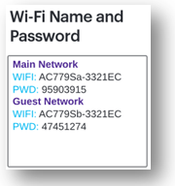
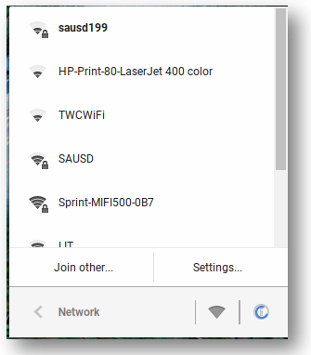
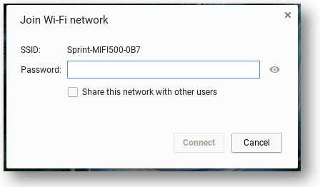
Connect the Chromebook to the hotspot
4. Find the hotspot WiFi name and Password on
the WiFi Name and Password LCD screen.
5. Select your home wireless WiFi or the SAUSD Hotspot by name.
6. Enter the WiFi password from your SAUSD hotspot.
7. Select Connect

Slide 12
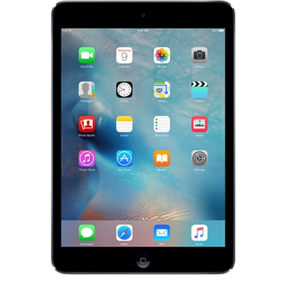
Questions

